Slide 1
SQL
Marius Cristescu
Software Architect

Slide 2

Before we start…
Hackathon
25th November

Slide 3
AGENDA
SQL constraints
Aggregate functions
Alter table
JOINs
Database view
Union Operator
String and Date Functions

Slide 4
SQL Constraints EXAMPLES
create table persons(
cnp varchar(13) primary key,
last_name varchar(30) not null,
first_name varchar(40) not null,
address varchar(100) not null,
phone varchar(15) NOT NULL UNIQUE,
email varchar(50) UNIQUE
);
create table cars(
vin varchar(17) primary key,
plate_number varchar(7) not null,
cnp_owner varchar(13) not null,
brand varchar(20) not null,
model varchar(30),
production_year int,
registered boolean DEFAULT true,
price int default 10000,
CONSTRAINT fk_car_owner
FOREIGN KEY(cnp_owner)
REFERENCES persons(cnp)
);

Slide 5
AGGREGATe functions
MIN() function returns the smallest value of the selected column.
SELECT MIN(column_name) FROM table_name WHERE condition;
MAX() function returns the largest value of the selected column.
SELECT MAX(column_name) FROM table_name WHERE condition;

Slide 6
AGGREGATe functions
AVG() function returns the average value of a numeric column.
SELECT AVG(column_name) FROM table_name WHERE condition;
SUM() function returns the total sum of a numeric column.
SELECT SUM(column_name) FROM table_name WHERE condition;
COUNT() function returns the number of rows that matches a specified criterion.
SELECT COUNT(column_name) FROM table_name WHERE condition;

Slide 7
GROUP BY Statement
GROUP BY statement groups rows that have the same values into summary rows, like "find all books of one author".
GROUP BY statement is often used with aggregate functions (COUNT(), MAX(), MIN(), SUM(), AVG()) to group the result-set by one or more columns.
SELECT column_name(s) FROM table_name WHERE condition GROUP BY column_name(s)

Slide 8
HAVING CLAUSE
HAVING clause was added to SQL because the WHERE keyword cannot be used with aggregate functions.
SELECT column_name(s) FROM table_name WHERE condition GROUP BY column_name(s) HAVING condition ORDER BY column_name(s);

Slide 9
ALTER table statement
ALTER TABLE statement is used to add, delete, or modify columns in an existing table.
ALTER TABLE table_name ADD column_name datatype;
ALTER TABLE table_name DROP COLUMN column_name;
ALTER TABLE table_name ALTER COLUMN column_name TYPE datatype;
ALTER TABLE table_name RENAME COLUMN column_name TO new_column_name;

Slide 10
SQL JOIN
A JOIN clause is used to combine rows from two or more tables, based on a related column between them.
Let’s have a look again at our tables

Slide 11
DIFFEREnt types of sql joins
Here are the different types of the JOINs in SQL:
The following constraints are commonly used in SQL:
(INNER) JOIN: Returns records that have matching values in both tables
LEFT (OUTER) JOIN: Returns all records from the left table, and the matched records from the right table
RIGHT (OUTER) JOIN: Returns all records from the right table, and the matched records from the left table
FULL (OUTER) JOIN: Returns all records when there is a match in either left or right table

Slide 12
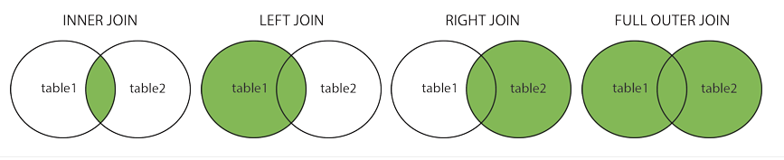
DIFFEREnt types of sql joins

Slide 13
sql INNER join
The INNER JOIN keyword selects records that have matching values in both tables.
Note: In some databases INNER JOIN is called just JOIN.
SELECT column_name(s) FROM table1
INNER JOIN table2 ON table1.column_name = table2.column_name;
We can JOIN more tables:
SELECT column_name(s) FROM table1
INNER JOIN table2 ON table1.column_name = table2.column_name;
INNER JOIN table3 ON table2.column_name = table3.column_name;

Slide 14
sql INNER join EXAMPLE
Show all columns from both tables:
select * from persons
JOIN cars ON persons.cnp = cars.cnp_owner
Show just some columns:
select persons.cnp, cars.plate_number, cars.brand from persons
JOIN cars ON persons.cnp =cars.cnp_owner

Slide 15
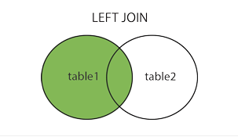
sql LEFT join
The LEFT JOIN keyword returns all records from the left table (table1), and the matching records from the right table (table2). The result is 0 records from the right side, if there is no match.
SELECT column_name(s) FROM table1
LEFT JOIN table2 ON table1.column_name = table2.column_name;

Slide 16
sql LEFT join EXAMPLE
Show all rows:
select * from persons
LEFT JOIN cars ON persons.cnp =cars.cnp_owner
Show just some rows:
select persons.cnp, cars.plate_number, cars.brand from persons
LEFT JOIN cars ON persons.cnp =cars.cnp_owner

Slide 17
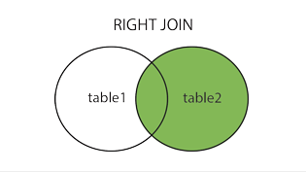
sql RIGHT join
The RIGHT JOIN keyword returns all records from the right table (table2), and the matching records from the left table (table1). The result is 0 records from the left side, if there is no match.
SELECT column_name(s) FROM table1
RIGHT JOIN table2 ON table1.column_name = table2.column_name;

Slide 18
sql RIGHT join EXAMPLE
Show all rows:
select * from persons
RIGHT JOIN cars ON persons.cnp =cars.cnp_owner
Show just some rows:
select persons.cnp, cars.plate_number, cars.brand from persons
RIGHT JOIN cars ON persons.cnp =cars.cnp_owner

Slide 19
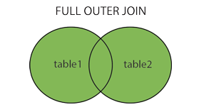
sql FULL join
The FULL JOIN keyword returns all records when there is a match in left (table1) or right (table2) table records.
Note: FULL JOIN can potentially return very large result-sets!
SELECT column_name(s) FROM table1
FULL JOIN table2 ON table1.column_name = table2.column_name;

Slide 20
sql FULL join EXAMPLE
Show all rows:
select * from persons
FULL JOIN cars ON persons.cnp =cars.cnp_owner
Show just some rows:
select persons.cnp, cars.plate_number, cars.brand from persons
FULL JOIN cars ON persons.cnp =cars.cnp_owner

Slide 21
SQL CREATE VIEW
In SQL, a view is a virtual table based on the result-set of an SQL statement.
A view contains rows and columns, just like a real table. The fields in a view are fields from one or more real tables in the database.
You can add SQL statements and functions to a view and present the data as if the data were coming from one single table.
CREATE VIEW view_name AS
SELECT column1, column2, ...
FROM table_name
WHERE condition;

Slide 22
SQL UNION OPerator
The UNION operator is used to combine the result-set of two or more SELECT statements.
Every SELECT statement within UNION must have the same number of columns
The columns must also have similar data types
The columns in every SELECT statement must also be in the same order

Slide 23
SQL UNION SYntax
SELECT column_name(s) FROM table1
UNION
SELECT column_name(s) FROM table2;
The UNION operator selects only distinct values by default. To allow duplicate values, use UNION ALL:
SELECT column_name(s) FROM table1
UNION ALL
SELECT column_name(s) FROM table2;

Slide 24
Coalesce function
The COALESCE function returns the first of its arguments that is not null. Null is returned only if all arguments are null. It is often used to substitute a default value for null values when data is retrieved for display, for example:
SELECT COALESCE(description, short_description, '(none)') FROM....

Slide 25
Coalesce function EXAMPLE
SELECT last_name, COALESCE(email, 'Unknown') as author FROM persons

Slide 26

STRING Functions EXAMPLES
select substring(cnp,1,4) from persons
select upper(last_name) from persons
select last_name, len(last_name) from persons
https://www.w3schools.com/sql/sql_ref_sqlserver.asp

Slide 27

Feedback form

Slide 28
0264 438 217
marius.cristescu@globallogic.com
www.fortech.ro

